Slide 1
Image Processing & Computer Vision
501837-3 and 501838-3
Dr. Mohammed Alghamdi

Slide 2

Course Materials
Main textbook: Computer Vision: Algorithms and Applications, 2nd edition by Richard Szeliski. can be downloaded for free here.
Other materials—including videos, code, research papers, book chapters, and lecture notes—will be provided for each topic as we proceed.

Slide 3





Course Assessments
Practical Lab: 10%
Quizzes: 10% - We will have 3 quizzes
Assignments or projects: 20% - We will have 2
Midterm exam: 20% - in week 8
Final exam: 40%

Slide 4


Course Policy Description
Students are expected to attend, and be on time, for every class. This demonstrates professionalism and consideration for your fellow students and your Instructor. Students who miss class and/or are late for class may experience an impact on their grade by missing around 5%.
Students are expected to turn in all assigned materials in a timely manner. All late assignments will be penalized by deducting -2 from the final mark for everyday being late.

Slide 5



Course Policy Description
Students are expected to demonstrate professionalism and courtesy by either silencing or turning off all cell phones and/or other alarm or audible indicator devices.
Absence of more than 20% of lectures or Lab will lead to a FORBIDDEN status.
All communications with the prof-in-charge should be through University Email. As well, All correspondance emails should be written professionally. Any behavior misconduct will not be tolerated.
An original official excuse should be approved by the department chair and submitted to the prof-in-charge.

Slide 6
Course Policy Description
You are encouraged to collaborate and study together, but each student must submit their own work. Identical assignments will result in a zero for all involved, and copying from others, including past students or online sources, will also receive a zero.
The Instructors reserve the right to add to, and/or modify any of the above policies as needed to maintain an appropriate and effective educational atmosphere in the classroom and the laboratory. In the case that this occurs, all students will be notified in advance of implementation of the new and/or modified policy

Slide 7
What is computer vision?
automatically identifying objects in images or video
Extracting latent information from visual data
technology that interprets light stimuli
computers seeing/learning things that the programmers who made them didn't tell them
Mimicking the human perception of sight with computational algorithms
train computers to understand the visual world
The study of understanding the world through visual perception
a simulation of eyes
Converting images to more understandable things like distance, edges, directions etc.
Computer getting information out of images/video
Giving the computer "eyes" to see and identify as humans would.
Teach computer to interpret and understand our world through images.
Notes:
Clips: terminator 2, enemy of the state (from UCSD “Fact or Fiction” DVD)

Slide 8
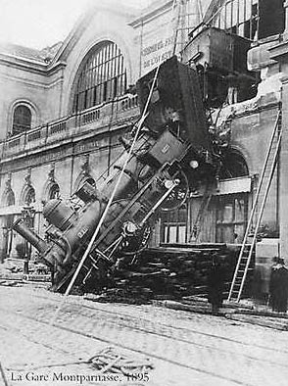
Every picture tells a story
Goal of computer vision is to write computer programs that can interpret images

Slide 9

What do computers see?
243 | 239 | 240 | 225 | 206 | 185 | 188 | 218 | 211 | 206 | 216 | 225
242 | 239 | 218 | 110 | 67 | 31 | 34 | 152 | 213 | 206 | 208 | 221
243 | 242 | 123 | 58 | 94 | 82 | 132 | 77 | 108 | 208 | 208 | 215
235 | 217 | 115 | 212 | 243 | 236 | 247 | 139 | 91 | 209 | 208 | 211
233 | 208 | 131 | 222 | 219 | 226 | 196 | 114 | 74 | 208 | 213 | 214
232 | 217 | 131 | 116 | 77 | 150 | 69 | 56 | 52 | 201 | 228 | 223
232 | 232 | 182 | 186 | 184 | 179 | 159 | 123 | 93 | 232 | 235 | 235
232 | 236 | 201 | 154 | 216 | 133 | 129 | 81 | 175 | 252 | 241 | 240
235 | 238 | 230 | 128 | 172 | 138 | 65 | 63 | 234 | 249 | 241 | 245
237 | 236 | 247 | 143 | 59 | 78 | 10 | 94 | 255 | 248 | 247 | 251
234 | 237 | 245 | 193 | 55 | 33 | 115 | 144 | 213 | 255 | 253 | 251
248 | 245 | 161 | 128 | 149 | 109 | 138 | 65 | 47 | 156 | 239 | 255
190 | 107 | 39 | 102 | 94 | 73 | 114 | 58 | 17 | 7 | 51 | 137
23 | 32 | 33 | 148 | 168 | 203 | 179 | 43 | 27 | 17 | 12 | 8
17 | 26 | 12 | 160 | 255 | 255 | 109 | 22 | 26 | 19 | 35 | 24
slide by Larry Zitnick

Slide 10
Can computers match (or beat) human vision?
Yes and no (but mostly no!)
humans are much better at “hard” things
computers can be better at “easy” things

Slide 11
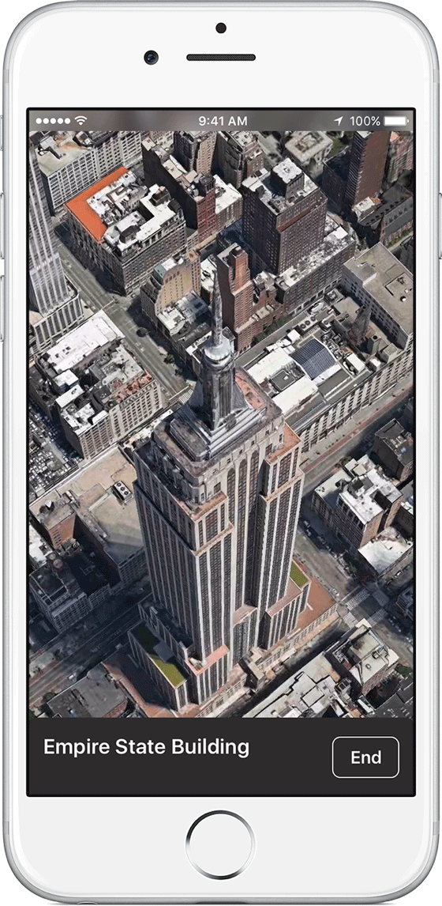
3D Maps
Apple Maps

Slide 12
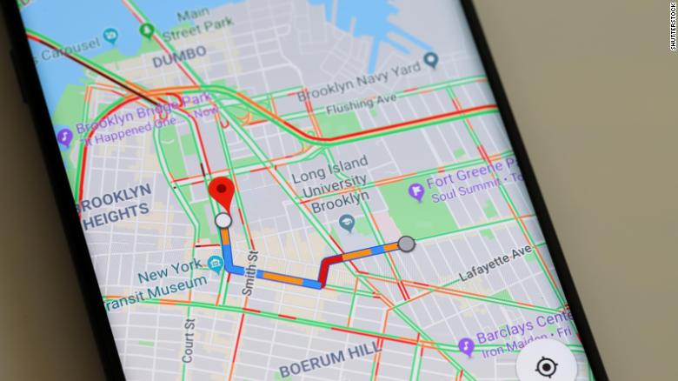
2D Maps
Google Maps

Slide 13
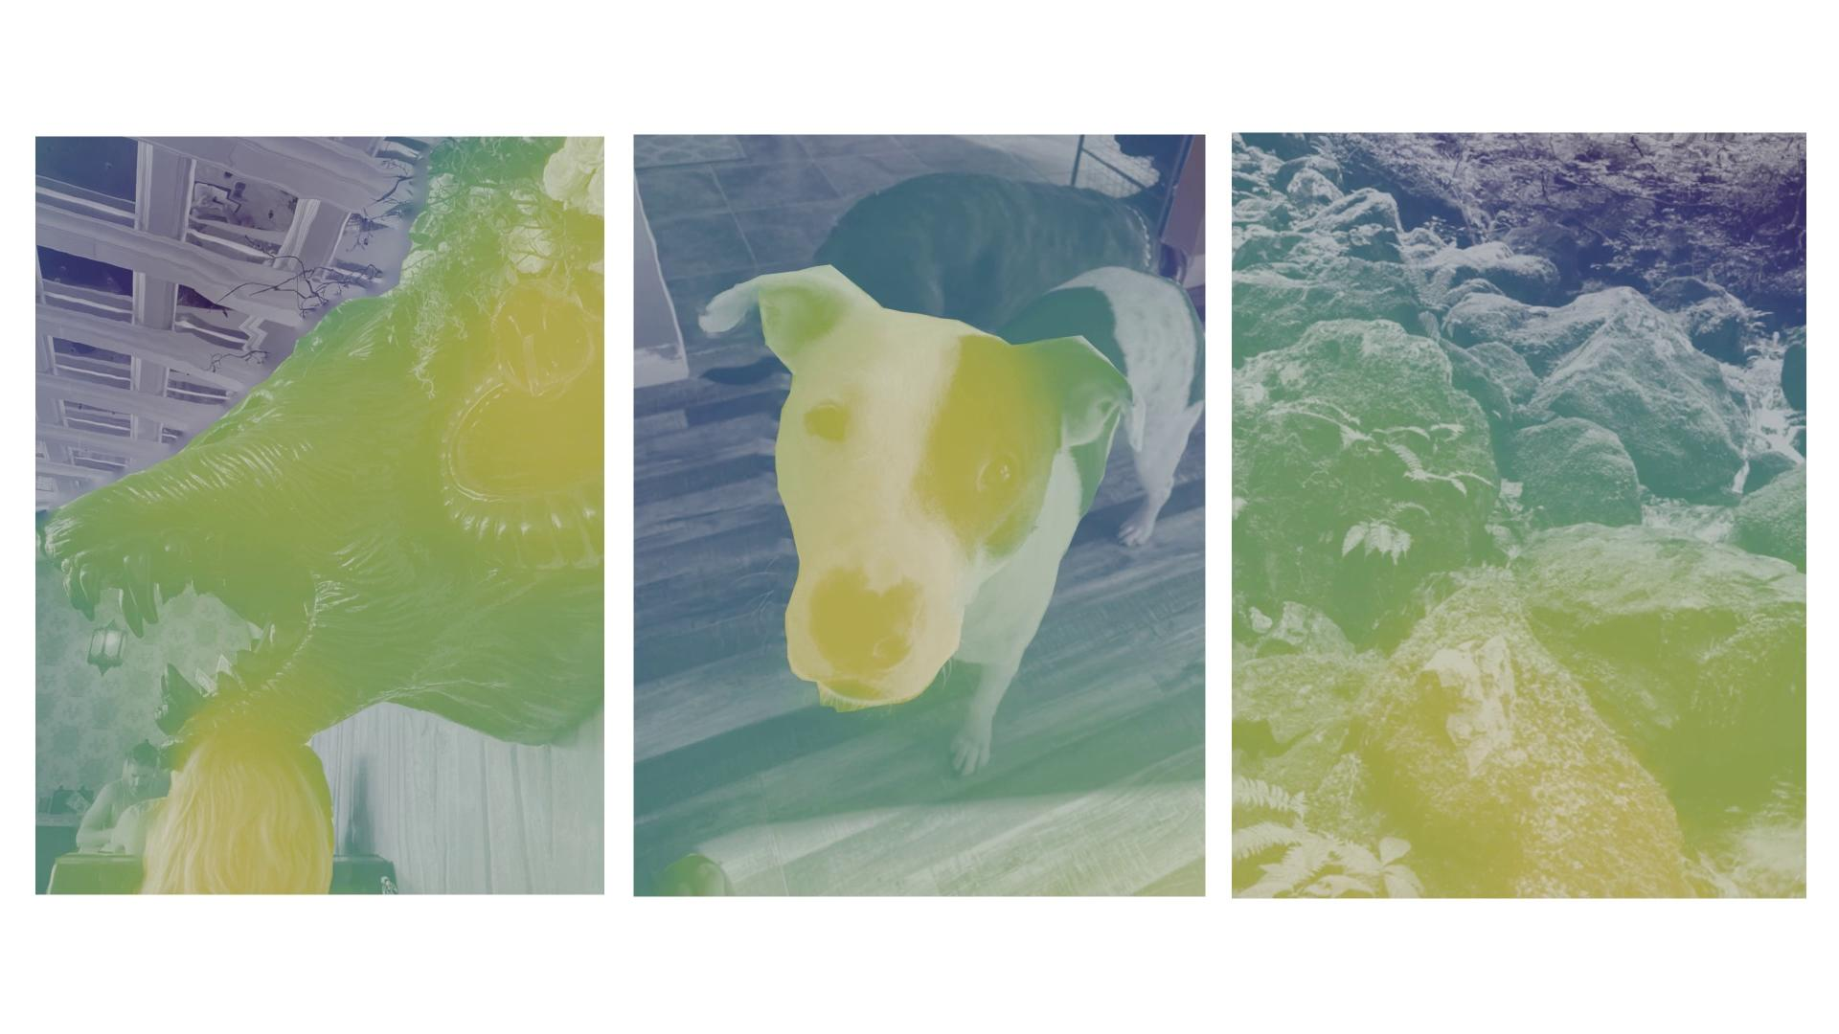
3D photos
3D Photos on Facebook
Estimate depth from photo to create animation
https://ai.facebook.com/blog/-powered-by-ai-turning-any-2d-photo-into-3d-using-convolutional-neural-nets/

Slide 14
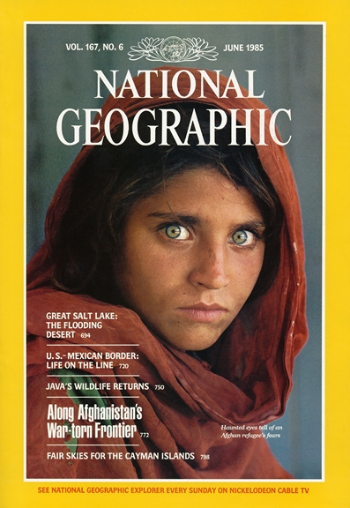
Face recognition
Who is she?

Slide 15
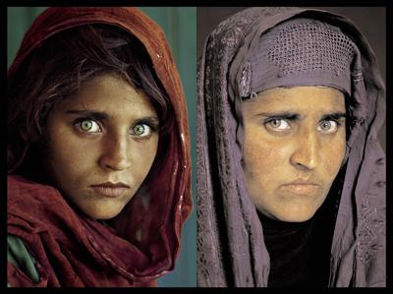
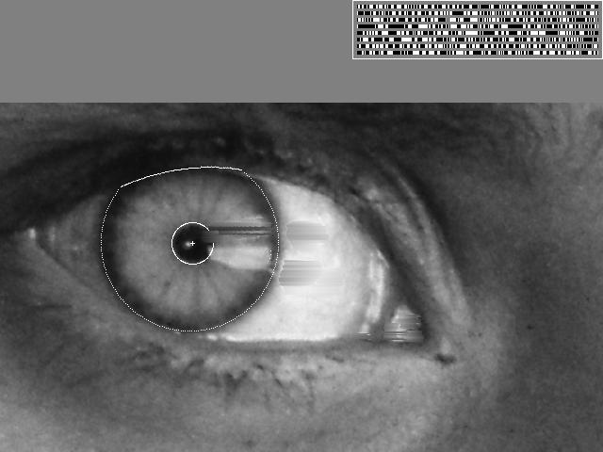
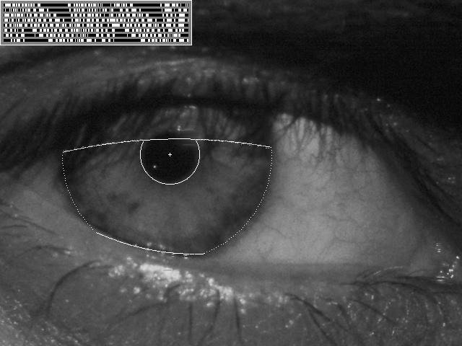
Vision-based biometrics
“How the Afghan Girl was Identified by Her Iris Patterns” Read the story

Slide 16
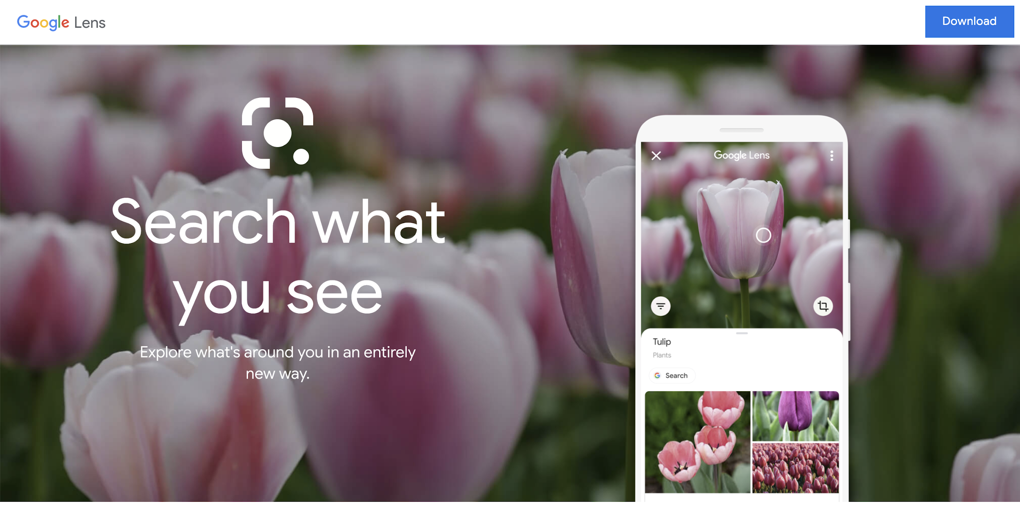
Object recognition

Slide 17
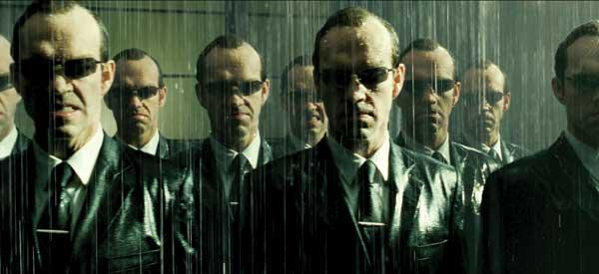
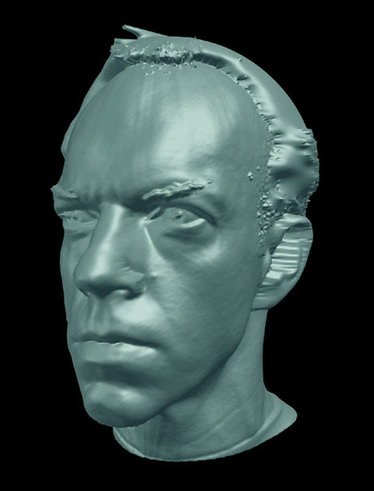
Special effects: shape capture
The Matrix movies, ESC Entertainment, XYZRGB, NRC

Slide 18
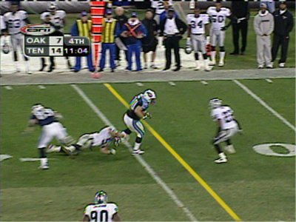
Sports
Sportvision first down line
Nice explanation on www.howstuffworks.com

Slide 19
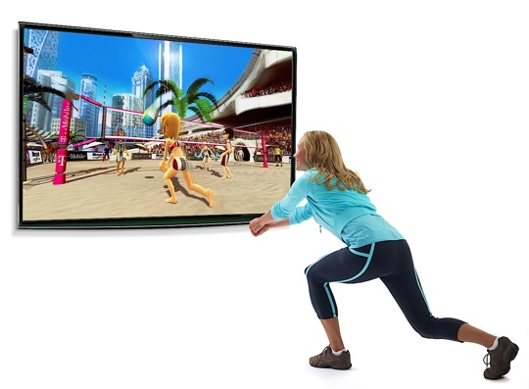
Games
Microsoft’s XBox Kinect

Slide 20

Virtual Reality
Oculus Quest, Beat Saber

Slide 21
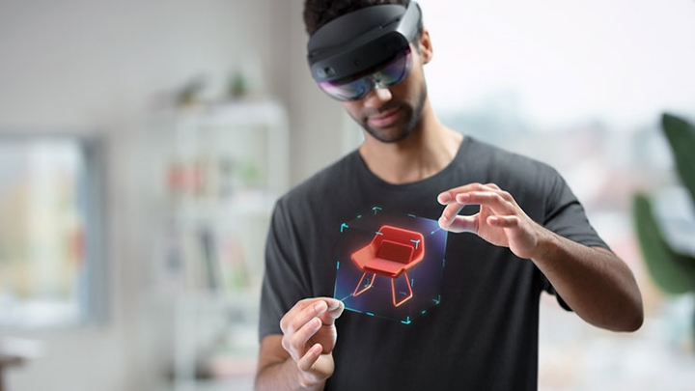
Augmented Reality
Microsoft Hololens 2

Slide 22
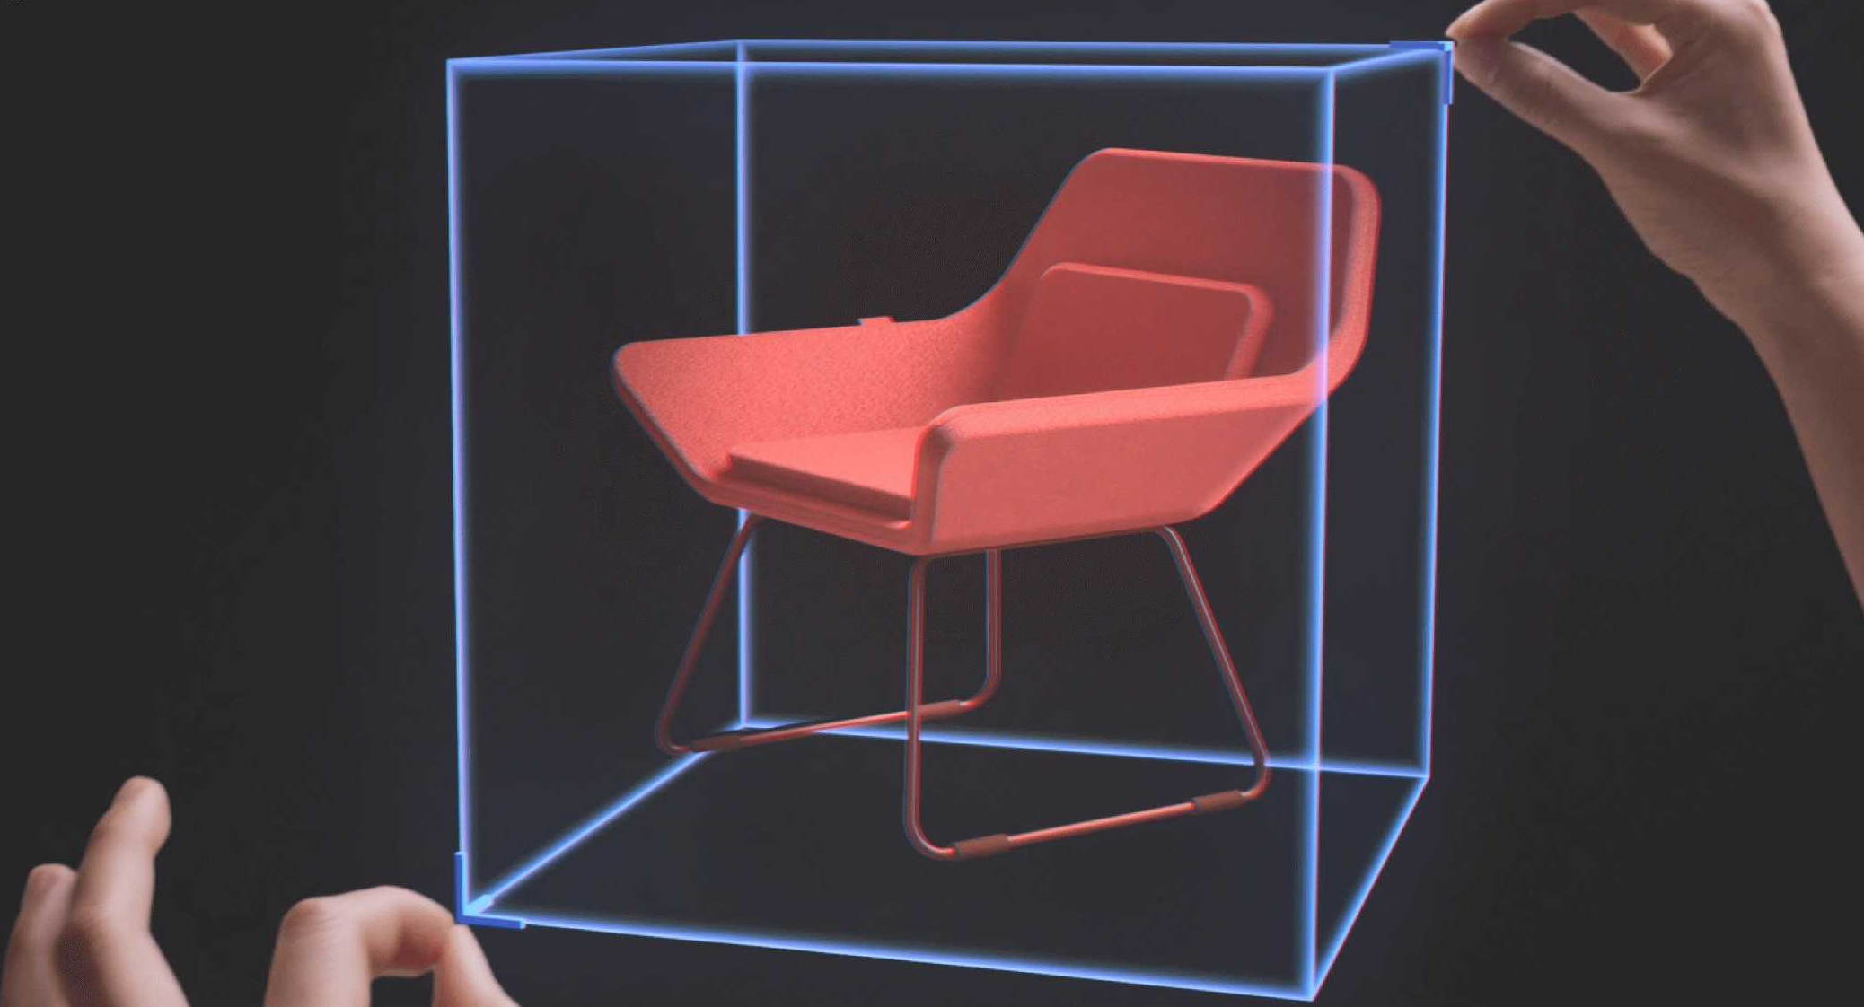
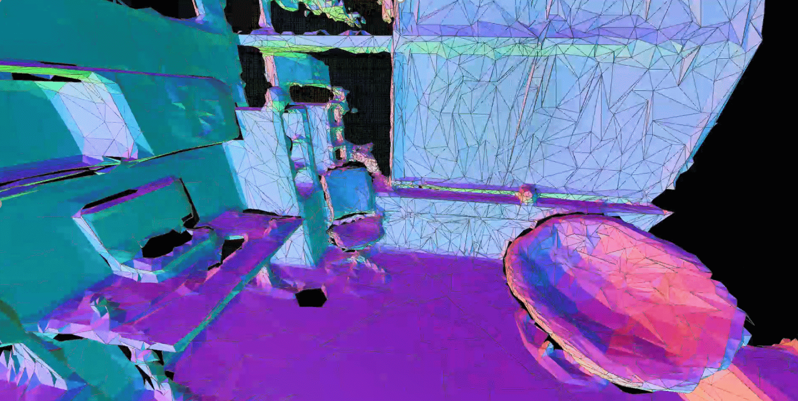
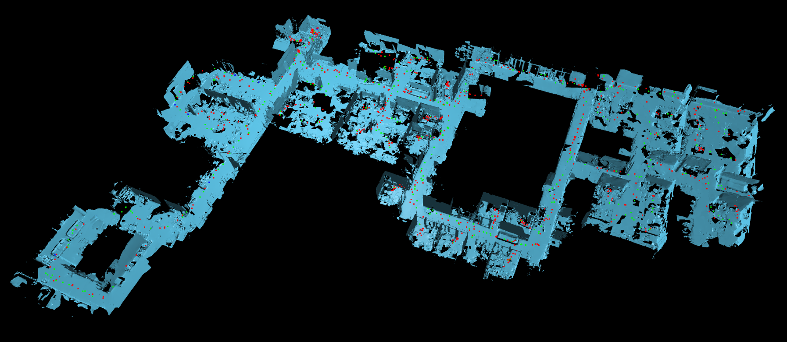
Augmented Reality

Slide 23

Body Tracking

Slide 24
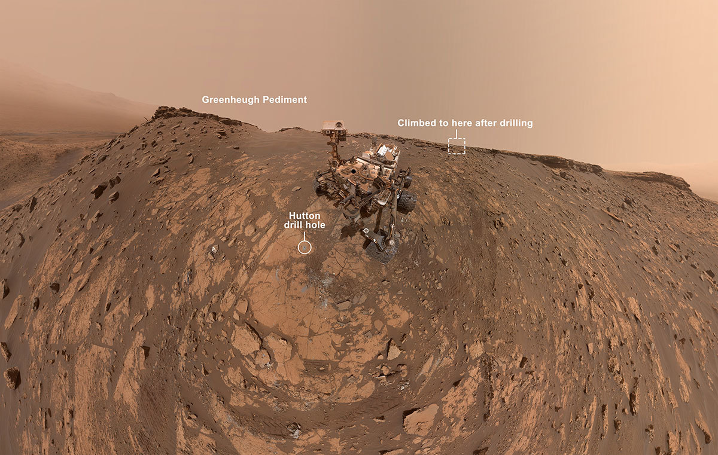
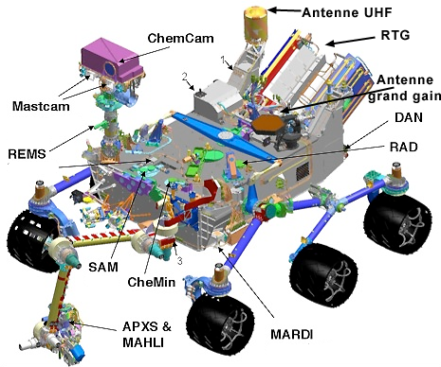
Robotics
NASA’s Mars Curiosity Rover (self portrait)
https://en.wikipedia.org/wiki/Curiosity_(rover)

Slide 25
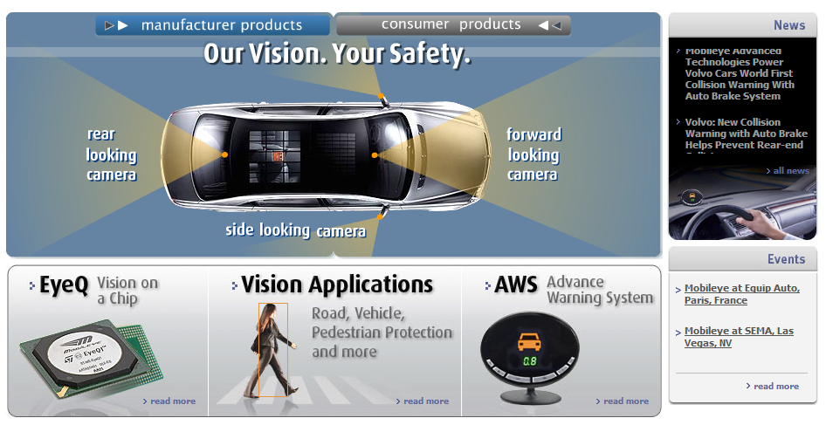
Smart cars
Slide content courtesy of Amnon Shashua
Mobileye
Vision systems currently in high-end BMW, GM, Volvo models

Slide 26
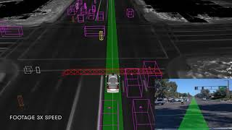
Self-driving cars

Slide 27
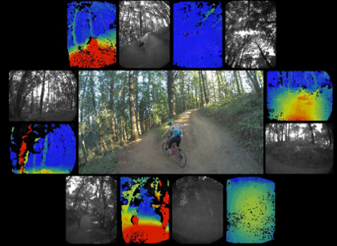
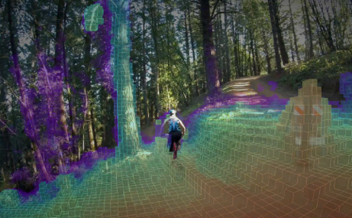
Drones
https://www.skydio.com/

Slide 28
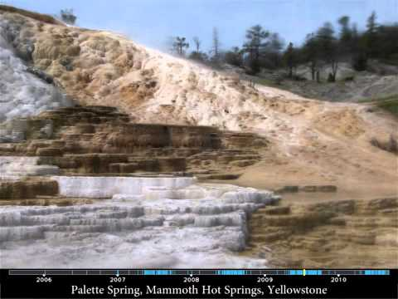
Research: Timelapse

Slide 29
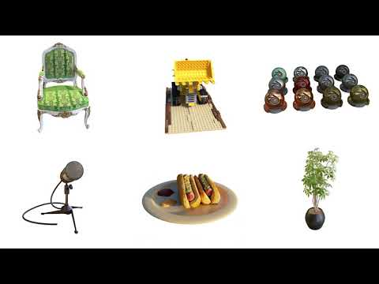
Research: Neural Rendering

Slide 30

Research: Yolo

Slide 31

Research: StyleGan

Slide 32
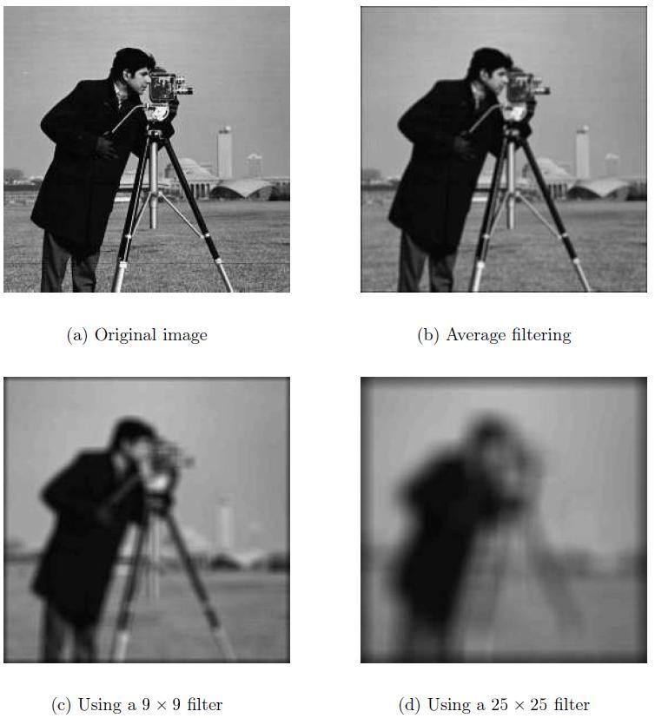
Filtering

Slide 33
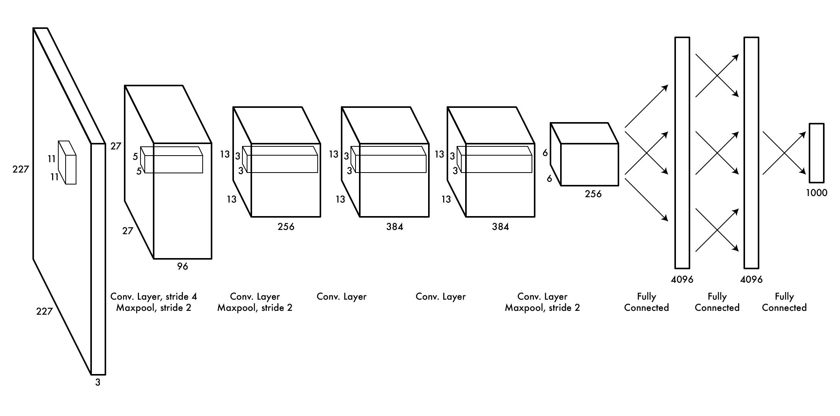
Machine Learning for Computer Vision
Low-level features Lines, oriented edges
Predictor Process features and predict output
Mid-level features Combine edges: curves, shapes
High-level features Combine shapes: objects, scenes

Slide 34
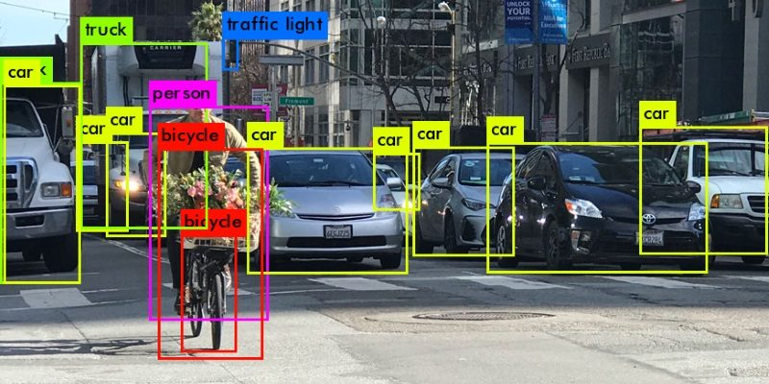
Object Detection
https://heartbeat.fritz.ai/introduction-to-basic-object-detection-algorithms-b77295a95a63

Slide 35
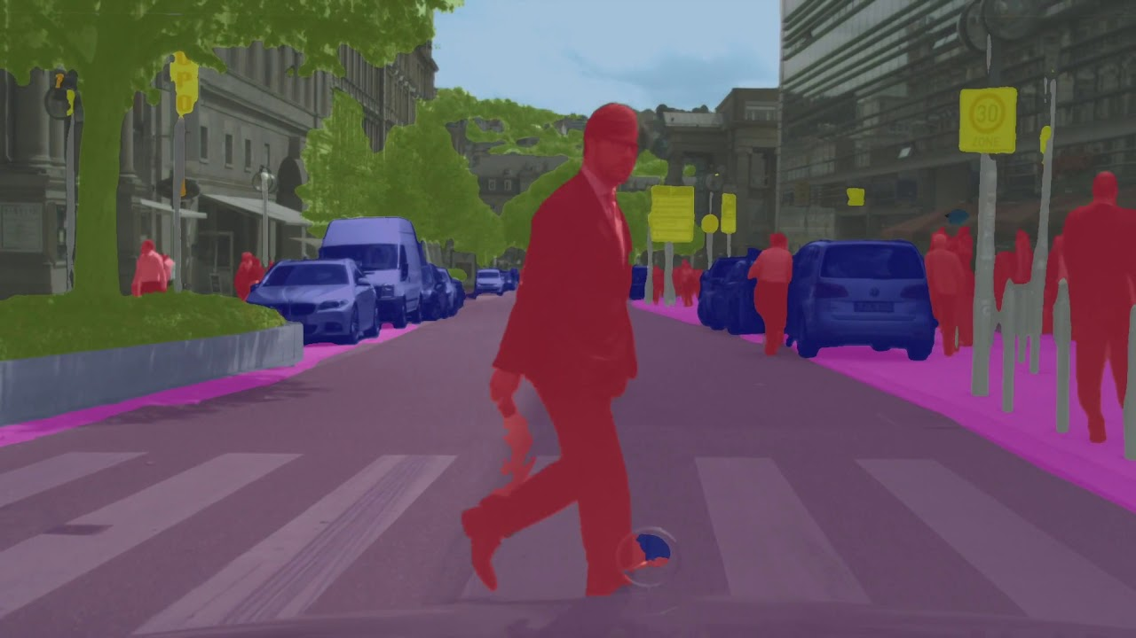
Segmentation
https://gts.ai/how-do-we-solve-the-challenges-faced-due-to-semantic-segmentation/

Slide 36
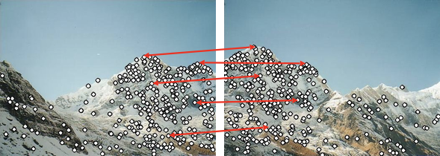
Features

Slide 37
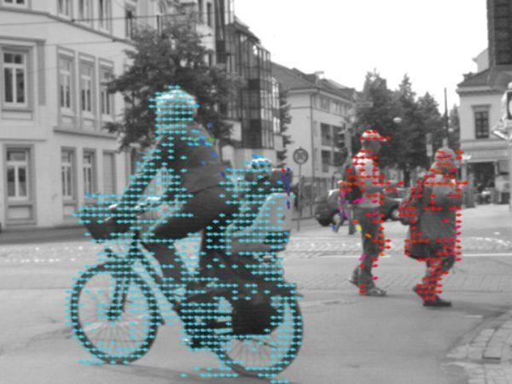
Optical Flow
https://www.commonlounge.com/discussion/1c2eaa85265f47a3a0a8ff1ac5fbce51

Slide 38
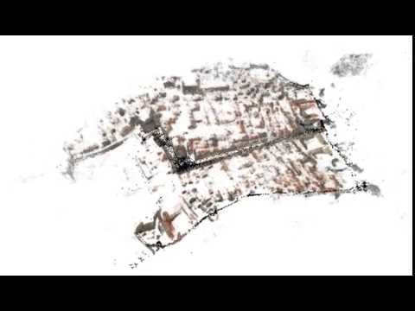
3D Mapping (SLAM and SfM)

Slide 39
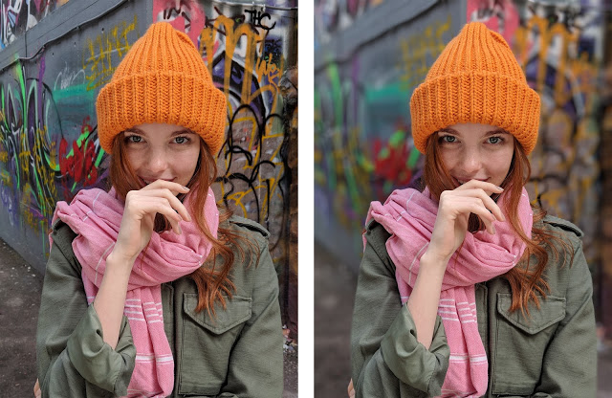
Computational Photography
https://ai.googleblog.com/2017/10/portrait-mode-on-pixel-2-and-pixel-2-xl.html

Slide 40

Generative Adversarial Networks (GANs)
GauGAN, NVidia https://arxiv.org/abs/1903.07291

Slide 41
Hololens

Slide 42
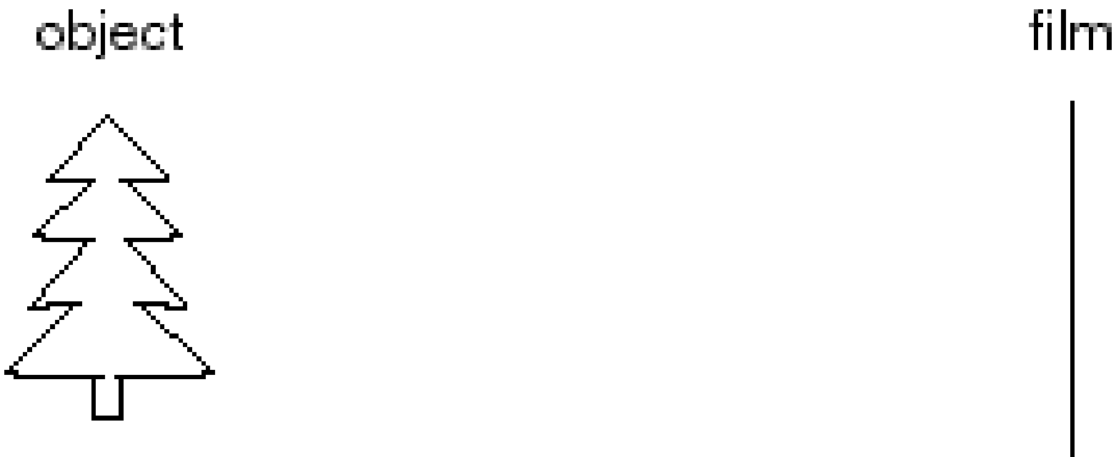
Image formation
Let’s design a camera
Idea 1: put a piece of film in front of an object
Do we get a reasonable image?

Slide 43
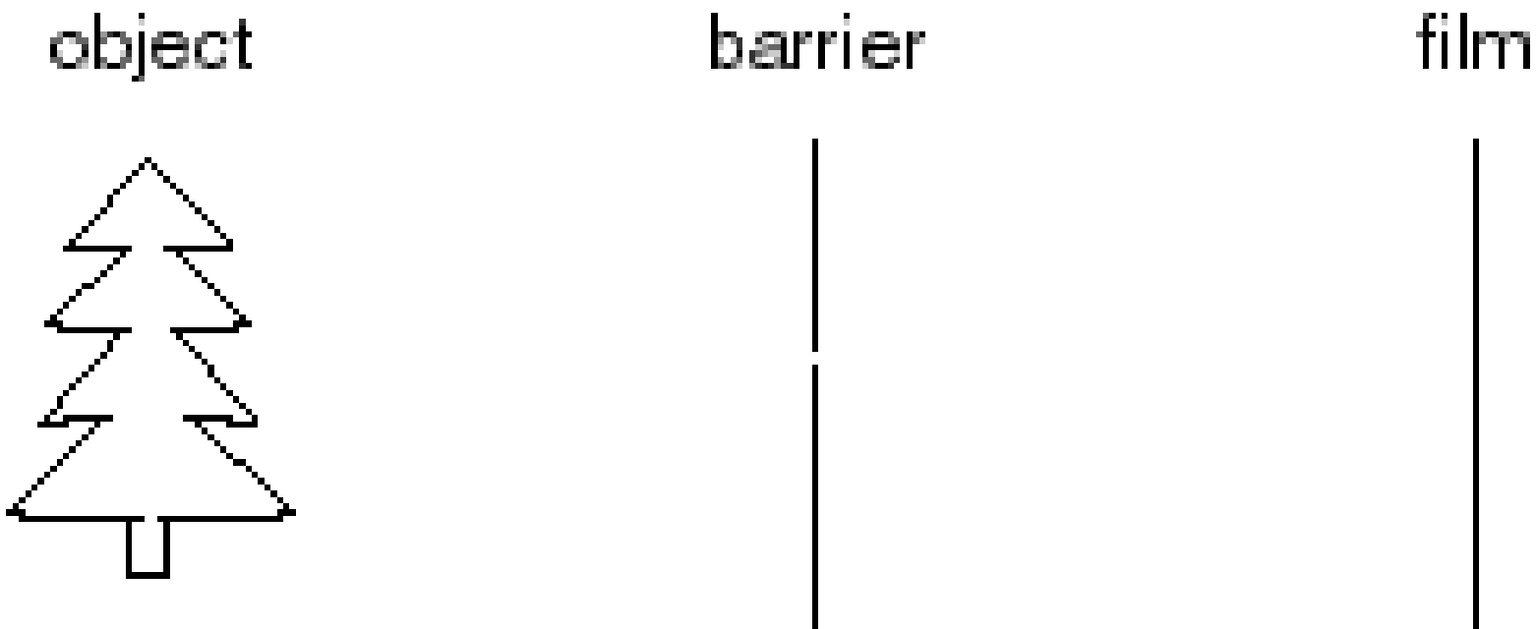
Pinhole camera
Add a barrier to block off most of the rays
This reduces blurring
The opening known as the aperture
How does this transform the image?

Slide 44
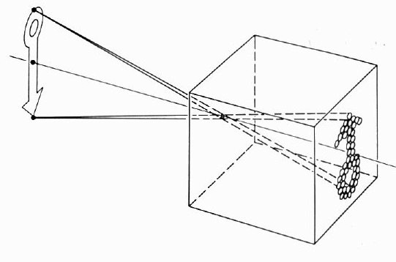
Pinhole Camera (Camera Obscura)

Slide 45

Pinhole cameras everywhere
Sun “shadows” during a solar eclipse by Henrik von Wendt http://www.flickr.com/photos/hvw/2724969199/

Slide 46

Pinhole cameras everywhere
Sun “shadows” during a solar eclipse http://www.flickr.com/photos/73860948@N08/6678331997/

Slide 47
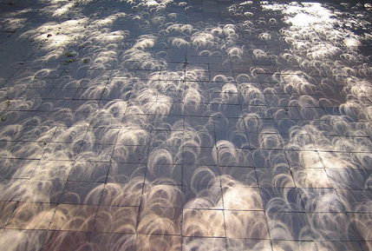
Pinhole cameras everywhere
Tree shadow during a solar eclipse
photo credit: Nils van der Burg http://www.physicstogo.org/index.cfm

Slide 48
Camera Obscura
The first camera
How does the aperture size affect the image?

Slide 49
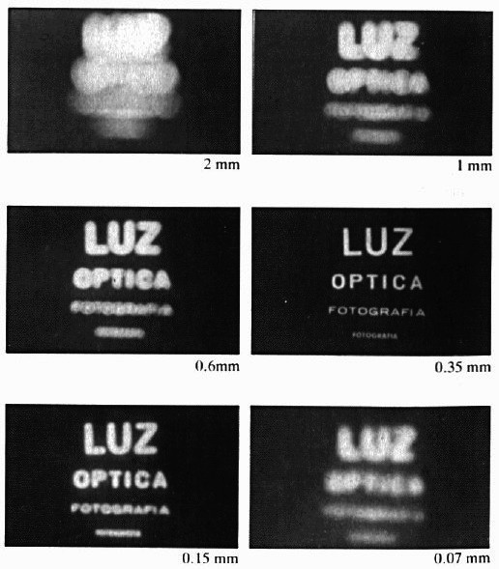
Shrinking the aperture
Why not make the aperture as small as possible?

Slide 50
Shrinking the aperture

Slide 51
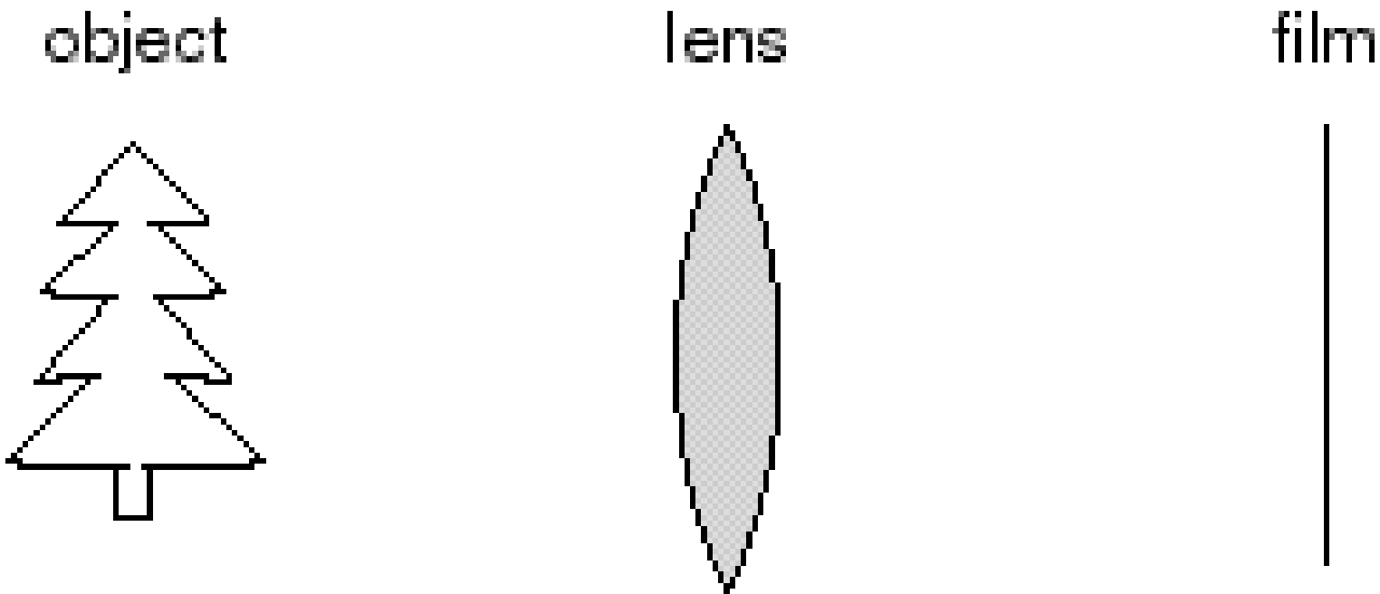
Adding a lens
“circle of
confusion”
A lens focuses light onto the film
There is a specific distance at which objects are “in focus”
other points project to a “circle of confusion” in the image
Changing the shape of the lens changes this distance

Slide 52
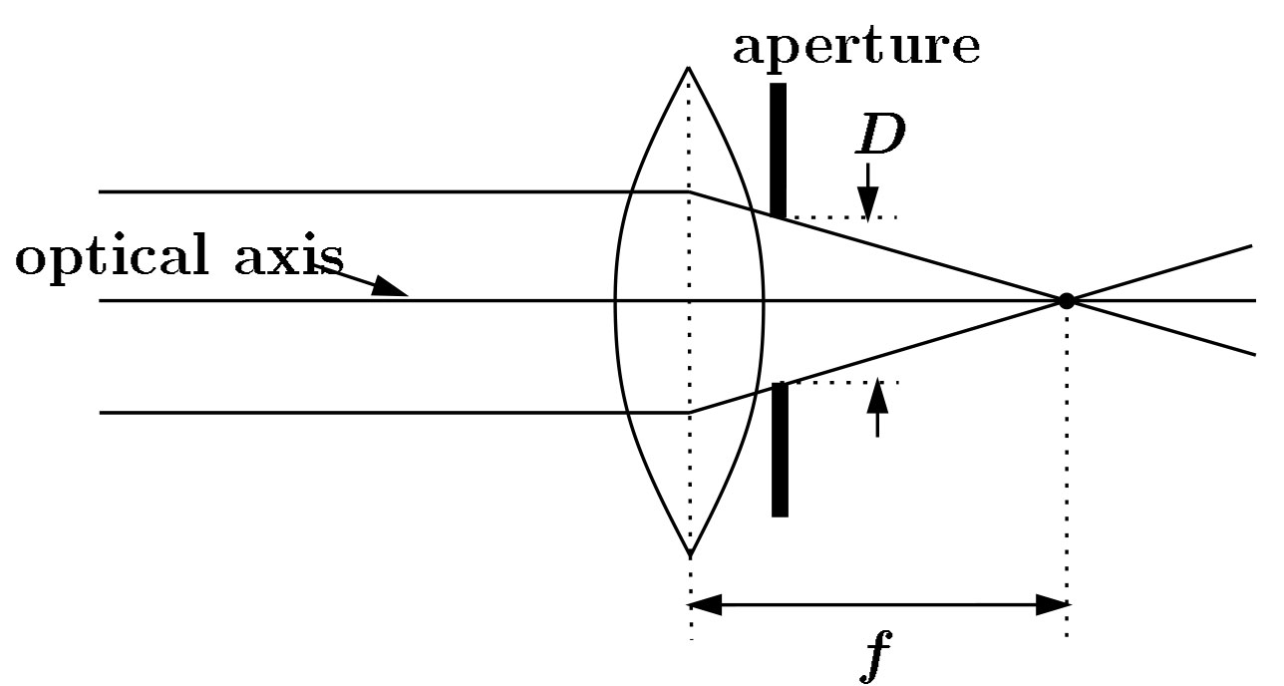
Lenses
F
focal point
optical center
(Center Of Projection)
A lens focuses parallel rays onto a single focal point
focal point at a distance f beyond the plane of the lens
f is a function of the shape and index of refraction of the lens
Aperture of diameter D restricts the range of rays
aperture may be on either side of the lens
Lenses are typically spherical (easier to produce)

Slide 53
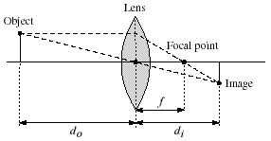
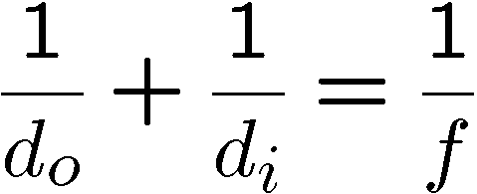
Thin lenses
Thin lens equation:
Any object point satisfying this equation is in focus
What is the shape of the focus region?
How can we change the focus region?
Thin lens applet: http://www.phy.ntnu.edu.tw/java/Lens/lens_e.html (by Fu-Kwun Hwang )

Slide 54

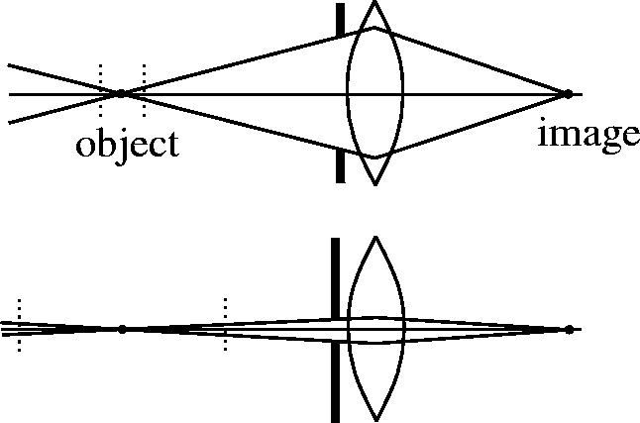
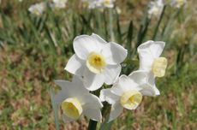
Depth of field
f / 5.6
f / 32
Changing the aperture size affects depth of field
A smaller aperture increases the range in which the object is approximately in focus
Flower images from Wikipedia http://en.wikipedia.org/wiki/Depth_of_field

Slide 55
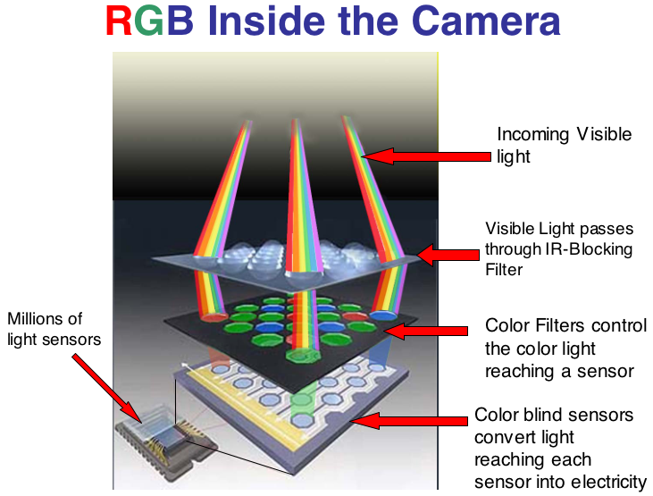
From light to pixels
https://sites.google.com/a/globalsystemsscience.org/digital-earth-watch/tools/digital-cameras-overview/what-happens-to-the-near-infared-entering-the-camera

Slide 56
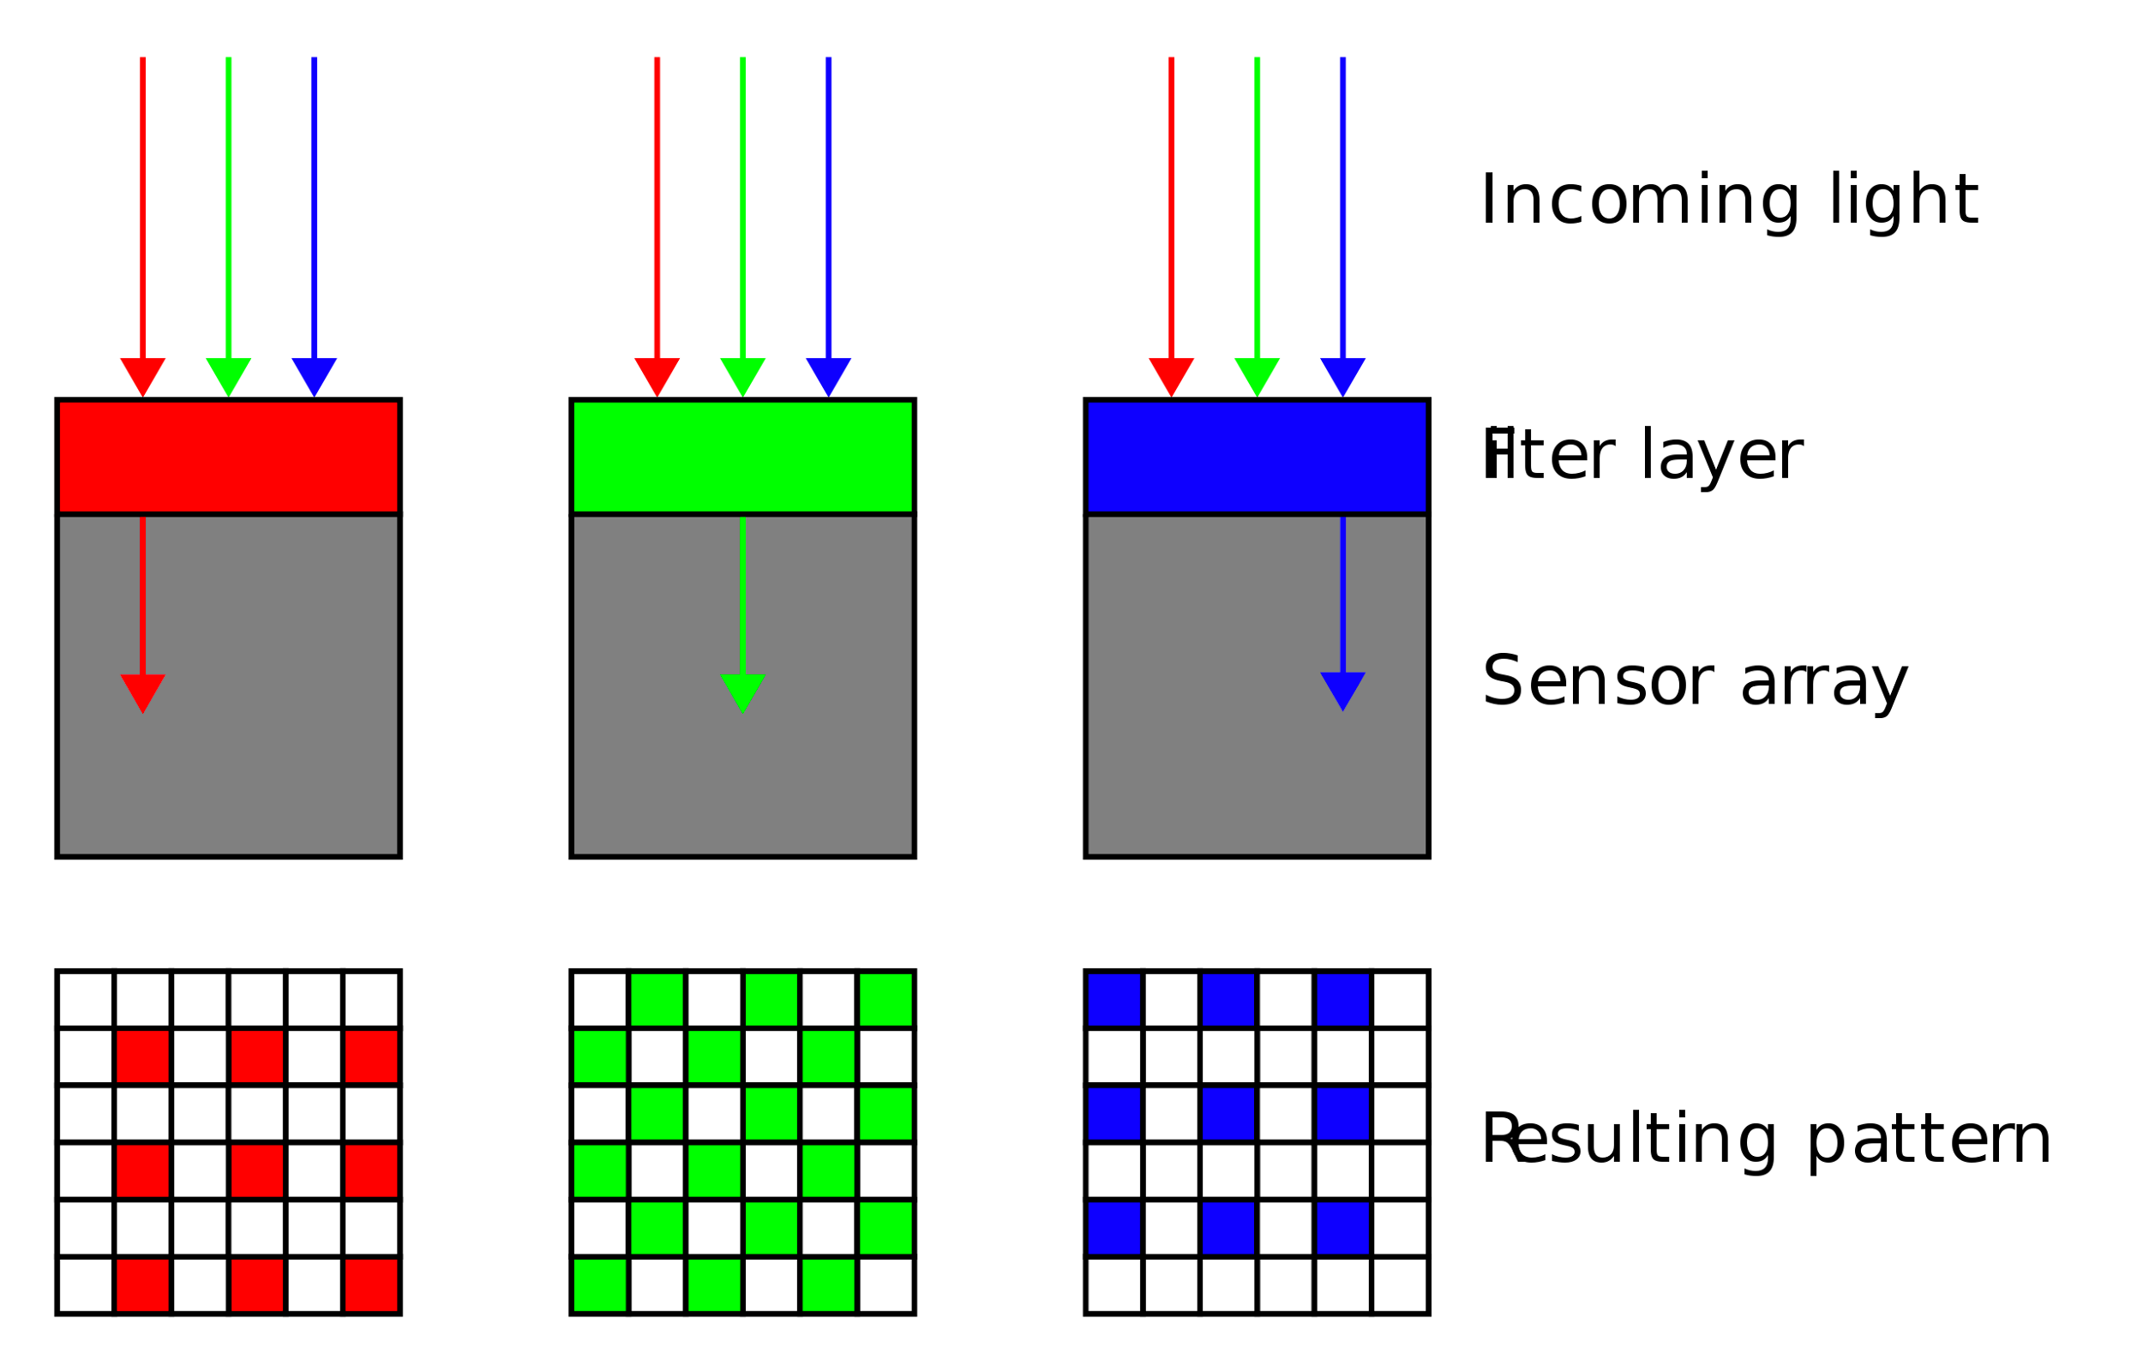
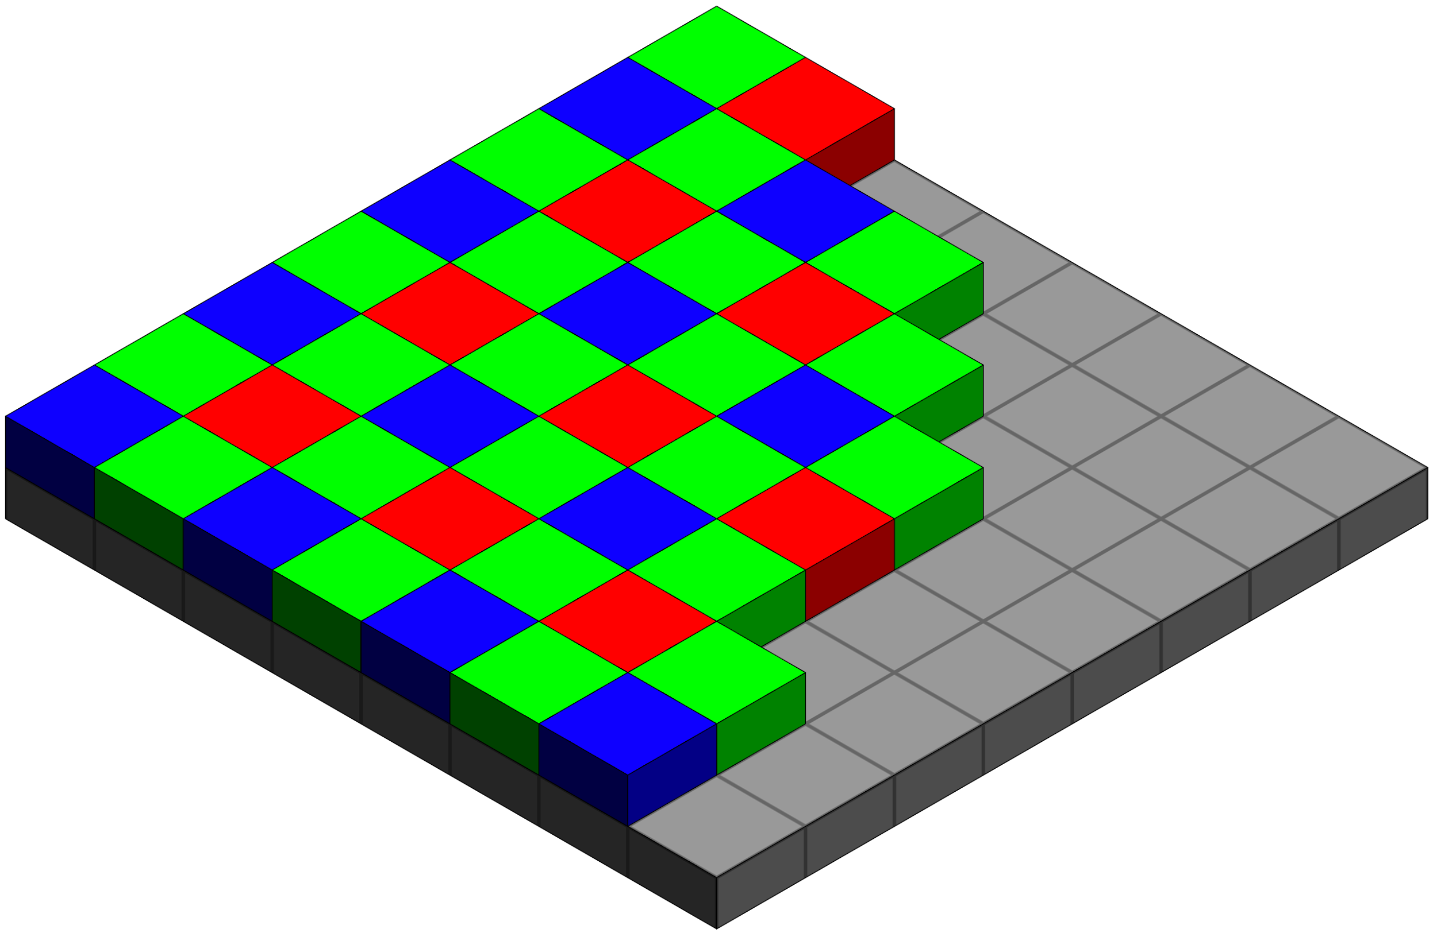
Bayer filters
https://en.wikipedia.org/wiki/Bayer_filter
¼ of pixels see red light (e.g.)
Q: how do you get red at every pixel?
A: Need to interpolate -- called debayering

Slide 57
Debayering
100
10
30
50
50
100
10
30
10
¼ of pixels see red light (e.g.)
Q: how do you get red at every pixel?
A: Need to interpolate -- called debayering

Slide 58
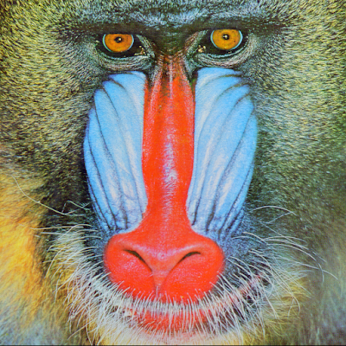
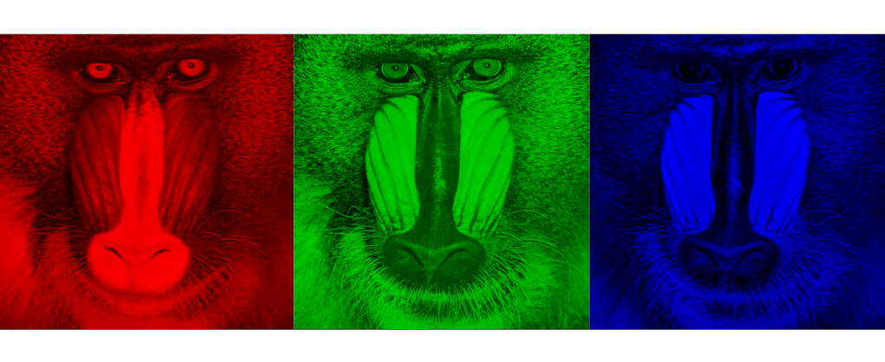
RGB images (three channel)
what we see
What we get out of the camera

Slide 59
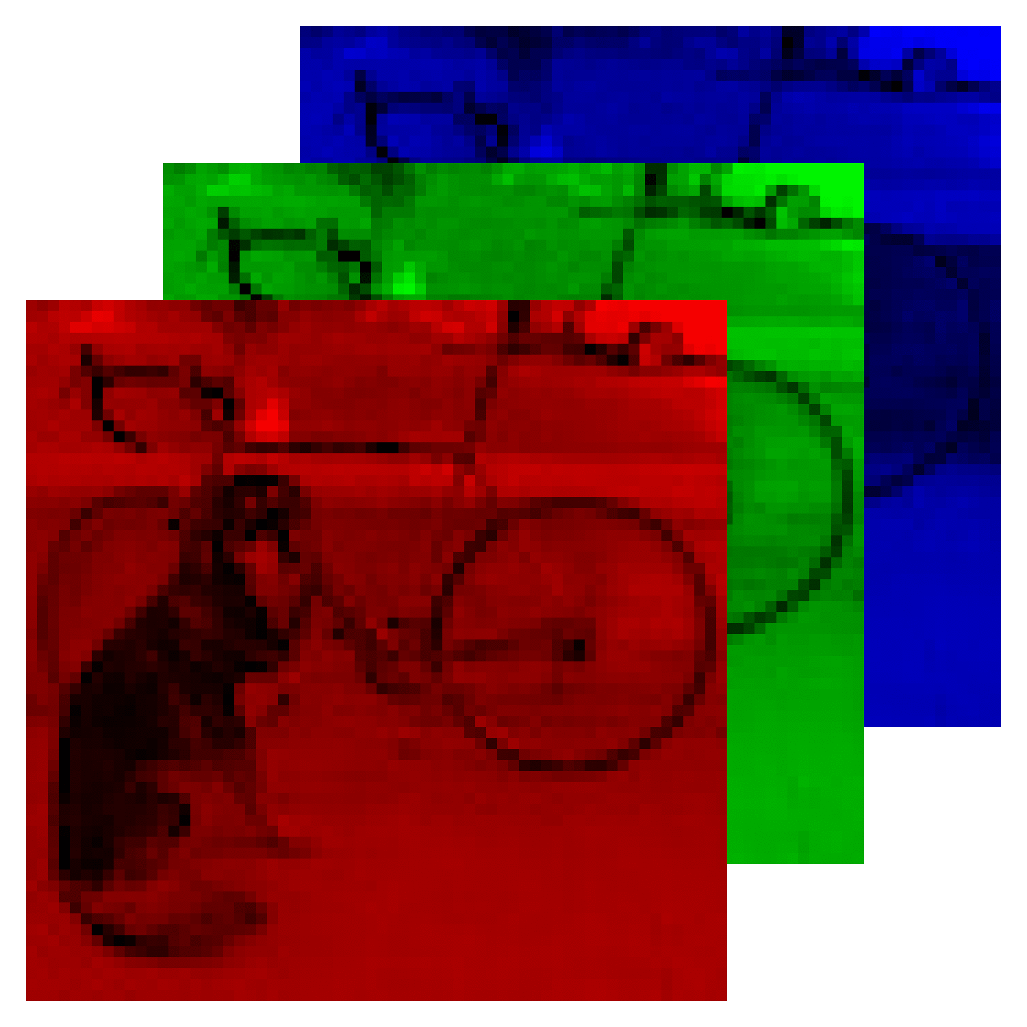
Images

Slide 60
From now on: what to do with these RGB images!

